Slide 1
The Value of the UML
Is an open standard
Supports the entire software development lifecycle
Supports diverse applications areas
Is based on experience and needs of the user community
Supported by many tools

Slide 2
What is UML?
Unified Modeling Language
OMG Standard, Object Management Group
Based on work from Booch, Rumbaugh, Jacobson
UML is a modeling language to express and design documents, software
Particularly useful for OO design
Not a process, but some have been proposed using UML
Independent of implementation language

Slide 3
Why use UML
Open Standard, Graphical notation for
Specifying, visualizing, constructing, and documenting software systems
Language can be used from general initial design to very specific detailed design across the entire software development lifecycle
Increase understanding/communication of product to customers and developers
Support for diverse application areas
Support for UML in many software packages today (e.g. Visual Studio, plugins for popular IDE’s like NetBeans, Eclipse)
Based upon experience and needs of the user community

Slide 4
Brief History
Inundated with methodologies in early 90’s
Booch, Jacobson, Yourden, Rumbaugh
Booch, Jacobson merged methods 1994
Rumbaugh joined 1995
1997 UML 1.1 from OMG includes input from others, e.g. Yourden
UML v2.4 current version (2.5 soon?)

Slide 5
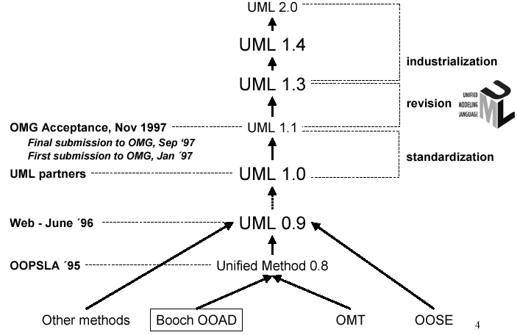
History of UML

Slide 6
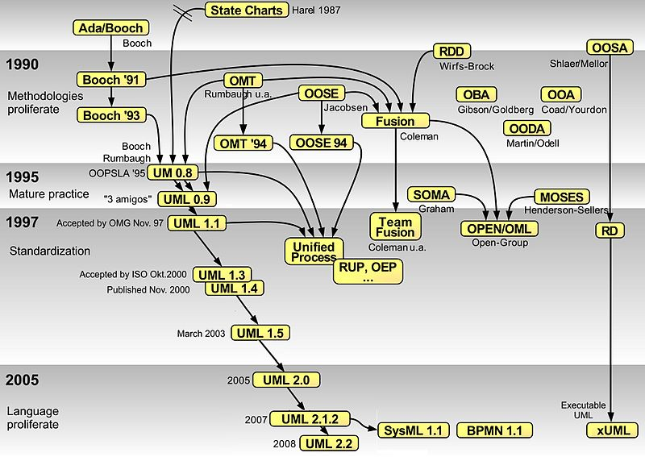

Slide 7
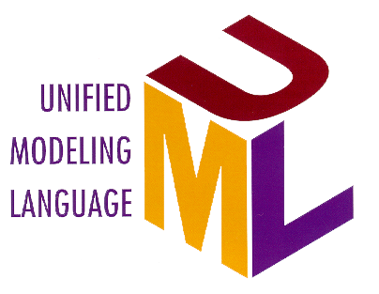
Contributions to the UML
Harel
Meyer
Gamma, et al
Statecharts
Before and after
conditions
Frameworks and patterns,
HP Fusion
Booch
Operation descriptions and
message numbering
Booch method
Rumbaugh
Embley
OMT
Singleton classes and
high-level view
Jacobson
Wirfs-Brock
OOSE
Responsibilities
Shlaer - Mellor
Odell
Object lifecycles
Classification

Slide 8
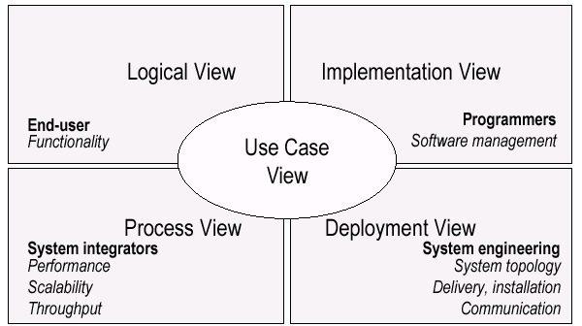
UML Models, Views, Diagrams
UML is a multi-diagrammatic language
Each diagram is a view into a model
Diagram presented from the aspect of a particular stakeholder
Provides a partial representation of the system
Is semantically consistent with other views
Example views

Slide 9
Models, Views, and Diagrams
A model is a complete
description of a system
from a particular
perspective
State
Diagrams
State
Diagrams
Class
Diagrams
Use Case
Diagrams
Use Case
Diagrams
State
Diagrams
Use Case
Diagrams
Use Case
Diagrams
State
Diagrams
Use Case
Diagrams
Object
Diagrams
Sequence
Diagrams
Scenario
Diagrams
State
Diagrams
Scenario
Diagrams
State
Diagrams
Collaboration
Diagrams
Component
Diagrams
Models
Scenario
Diagrams
Component
Diagrams
Scenario
Diagrams
Component
Diagrams
Statechart
Diagrams
Deployment
Diagrams
Activity
Diagrams

Slide 10
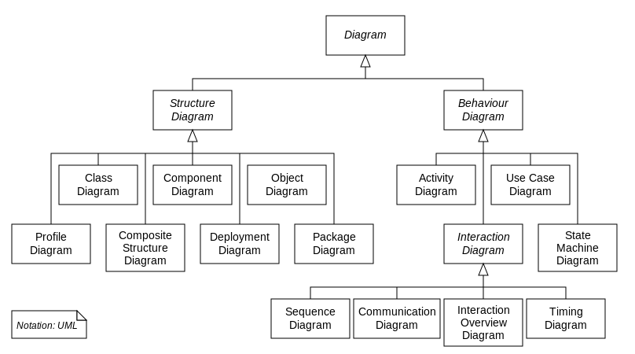
Models, Views, and Diagrams (updated)

Slide 11
UML: First Pass
You can model 80% of most problems by using about 20 % UML

Slide 12
UML Baseline (Most frequently used)
Use Case Diagrams
Class Diagrams
Package Diagrams
Interaction Diagrams
Sequence
Collaboration
Activity Diagrams
State Transition Diagrams
Deployment Diagrams
UML diagrams
Structural UML diagrams
Class diagram Component diagram Composite structure diagram Deployment diagram Object diagram Package diagram Profile diagram
Behavioral UML diagrams
Activity diagram Communication diagram Interaction overview diagram Sequence diagram State diagram Timing diagram Use case diagram

Slide 13
UML Partners
Rational Software Corporation
Hewlett-Packard
I-Logix
IBM
ICON Computing
Intellicorp
MCI Systemhouse
Microsoft
ObjecTime
Oracle
Platinum Technology
Taskon
Texas Instruments/Sterling Software
Unisys

Slide 14
Overview of the UML
The UML is a language for
visualizing
specifying
constructing
documenting
the artifacts of a software-intensive system

Slide 15
Overview of the UML
Modeling elements
Relationships
Extensibility Mechanisms
Diagrams

Slide 16
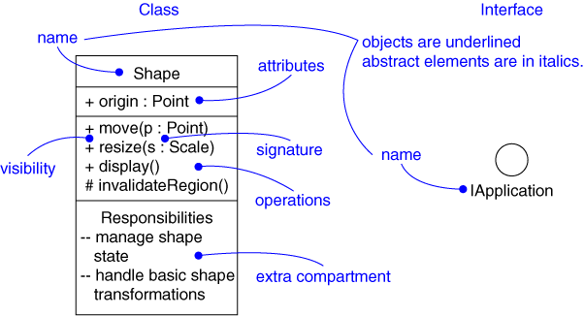
Modeling Elements
Structural elements
class, interface, collaboration, use case, active class, component, node
Behavioral elements
interaction, state machine
Grouping elements
package, subsystem
Other elements
note
Notes:
Class Normal
Object Underlined
Abstract class Italic
Visibility
# protected
+ Public
Private
Interface is a collection of operation that are used to specify a service of a class or a component
In an operation’s signature , you may provide zero or more parameters and/or return type, each of which follows the syntax set( n:name , s: string) :Status

Slide 17
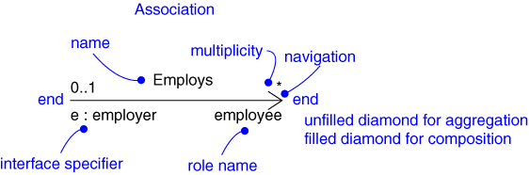
Relationships
Dependency
Association
Generalization
Realization
Notes:
Association is a structured relationship, specifing that Object od one thing that are connected to object of another, there are four basic adornment that apply to an association
Name what you call athing, relationship, or diagram; a string used to identify an element
The behaviour of an entity participating in a prticular context is known as Role at each end of association
The number of instance a class may have is called it’s Multiplicity at each end
Unfilled diamond for Aggregation ( A special form of association that specifies a wholw-part relationship between the aggregate(the whole) and a component (the part))
For advance uses
Navigation is by default bidirectional, However there are circumstances in which you’ll want to limit navigation to just one direction ( USER to PASSWORD, Given USER you will be able to find the corresponding PASSWORD, but given the PASSWORD don’t want to able to find the corresponding USER)
Qualification
Various flavours of aggregation,filled diamond for composition
Composition , 1) an object may be apart of only one composite at a time,in contrast to simple aggregation, in which a part may be shared by several wholes. 2)the whole is responsible for the disposition of its parts, which means that the composition must manage the creation and destruction of its parts
Interface is a collection of operation that are used to specify a service of a class or a component

Slide 18
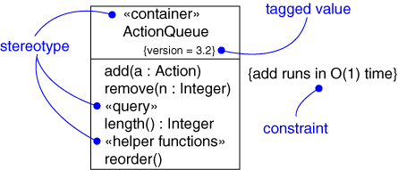
Extensibility Mechanisms
Stereotype
Tagged value
Constraint
Notes:
Stereotype An extension to the vocabulary of the UML. Which allows you to creaaat new kind of building blocks that are derived from existing ones but that aare specific to your problem
A stereotype is rendered as a name enclosed by guillemets (for example << name>> ) and placed above the name of another element.
You may define as icon for the stereotype and render that icon to the right of the name
Or can use icon as the basic symbol for the stereotype item.
Tagged values an extension of the properties of a UML element, which allows you to creat new information in that element’s specifications..
Im most caes, aa tagged value is rendered by palcing the tag naame and its valuebelow the naaame of the element to which itis attaached and enclosing the tagged vaalue in the breces, as in {Location = Client}
Constraint an extension of the semantic of a UML element, allowing you to add new rules or modify existing rules

Slide 19
Static vs. Dynamic Design
Static design describes code structure and object relations
Class relations
Objects at design time
Doesn’t change
Dynamic design shows communication between objects
Similarity to class relations
Can follow sequences of events
May change depending upon execution scenario
Called Object Diagrams

Slide 20
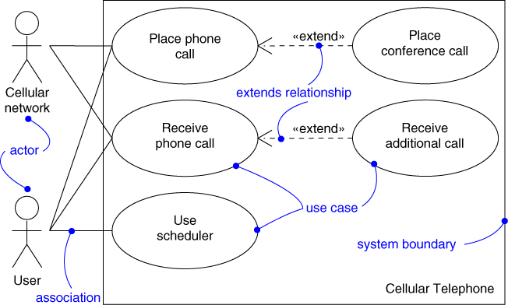
Use Case Diagram
Captures system functionality as seen by users
Notes:
Actor A coherent set of role that users of of usecaases play when interacting with the usecaases
Use case A description of a set of sequences of aactions, including variants, that a system perform that yields an abseraable result of value to an actor
Extends specifies that the target use case extends the behaviour of the source
Includes specifies that the source usecase explicitly incorporates the behaviour of another use case at a location specified by the source

Slide 21
Use Case Diagram
Captures system functionality as seen by users
Built in early stages of development
Purpose
Specify the context of a system
Capture the requirements of a system
Validate a system’s architecture
Drive implementation and generate test cases
Developed by analysts and domain experts

Slide 22
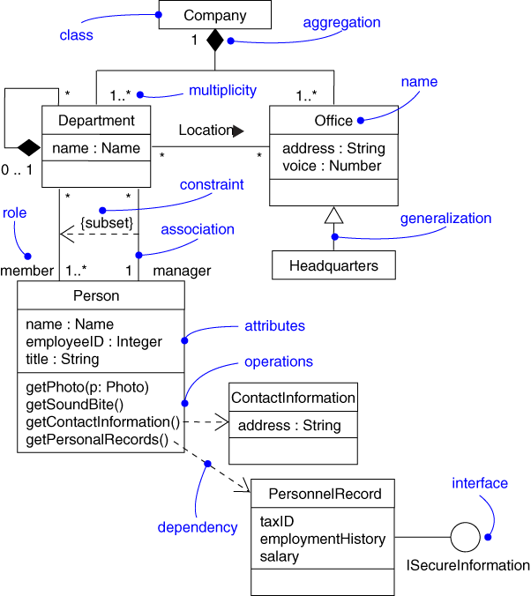
Class Diagram
Captures the vocabulary of a system
Notes:
Dependency A semantic relationship between two things in which achange to one thing( the independent thing) may effect the sementics of the other thing (the dependent thing).

Slide 23
Class Diagram
Captures the vocabulary of a system
Built and refined throughout development
Purpose
Name and model concepts in the system
Specify collaborations
Specify logical database schemas
Developed by analysts, designers, and implementers

Slide 24
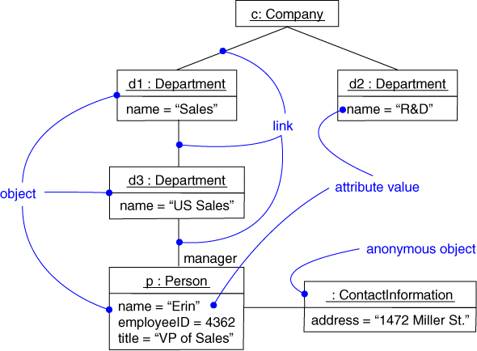
Object Diagram
Captures instances and links
Notes:
Object Diagram shows a set of objects and their relationship at a point in time : object diagrams aaddress the static design view or static process view of the system

Slide 25
Object Diagram
Shows instances and links
Built during analysis and design
Purpose
Illustrate data/object structures
Specify snapshots
Developed by analysts, designers, and implementers

Slide 26
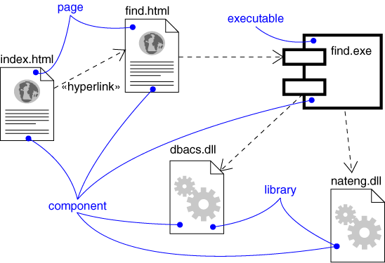
Component Diagram
Captures the physical structure of the implementation

Slide 27
Component Diagram
Captures the physical structure of the implementation
Built as part of architectural specification
Purpose
Organize source code
Construct an executable release
Specify a physical database
Developed by architects and programmers

Slide 28


Component Diagram Notation
Components are shown as rectangles with two tabs at the upper left
Dashed arrows indicate dependencies
Circle and solid line indicates an interface to the component

Slide 29
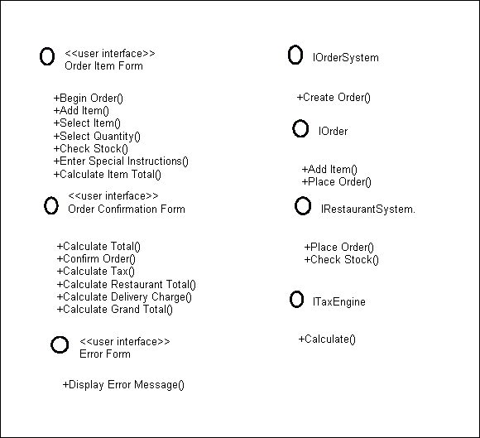
Component Example - Interfaces
Restaurant ordering system
Define interfaces first – comes from Class Diagrams

Slide 30
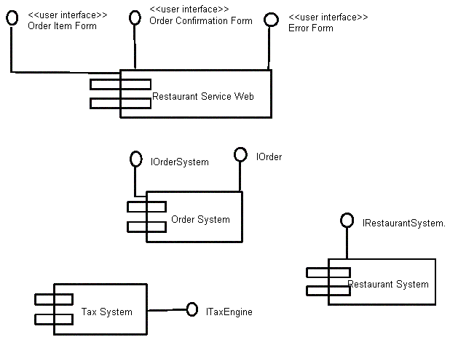
Component Example - Components
Graphical depiction of components

Slide 31
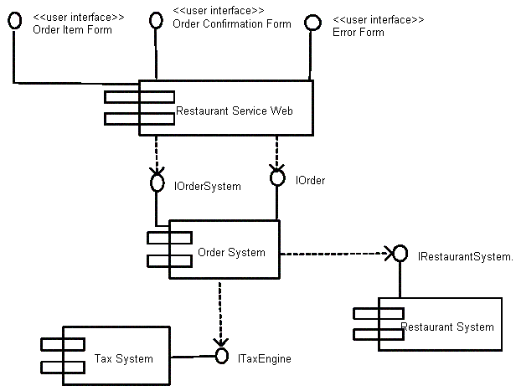
Component Example - Linking
Linking components with dependencies

Slide 32
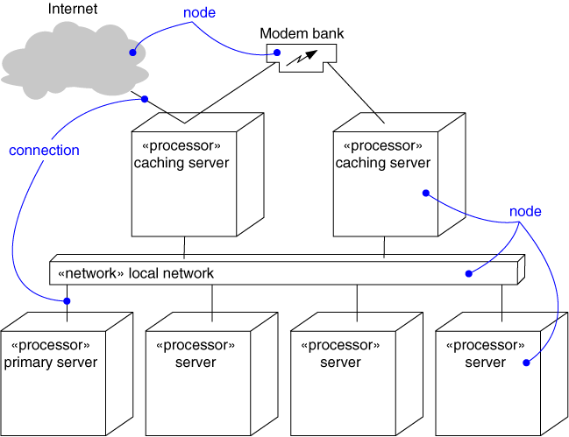
Deployment Diagram
Captures the topology of a system’s hardware

Slide 33
Deployment Diagram
Captures the topology of a system’s hardware
Built as part of architectural specification
Purpose
Specify the distribution of components
Identify performance bottlenecks
Developed by architects, networking engineers, and system engineers

Slide 34
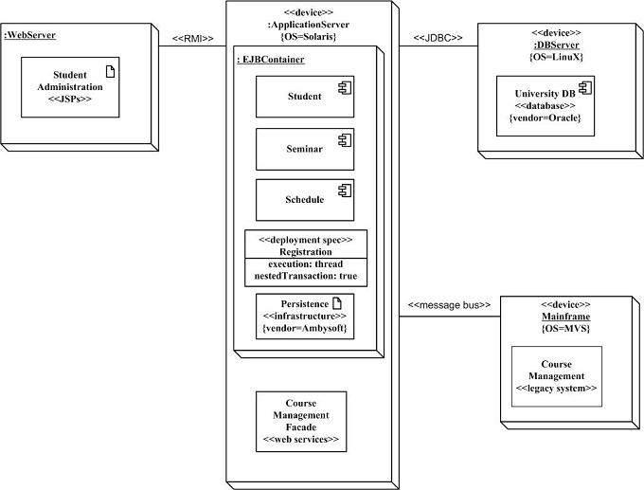
Structural Diagrams - Deployment Diagram (http://www.agilemodeling.com/artifacts/deploymentDiagram.htm)
Student administration application
Physical nodes - stereotype device
WebServer - physical device or
software artifact
RMI/message bus: connection type
Nodes can contain other nodes
or software artifacts recursively
Deployment specs: configuration files:
name and properties

Slide 35
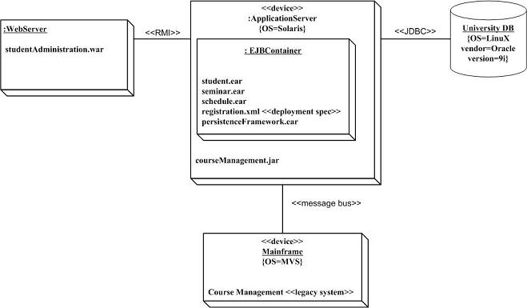
Structural Diagrams - Deployment Diagram (http://www.agilemodeling.com/artifacts/deploymentDiagram.htm)
Is this better?
More concrete
Implementation-oriented

Slide 36
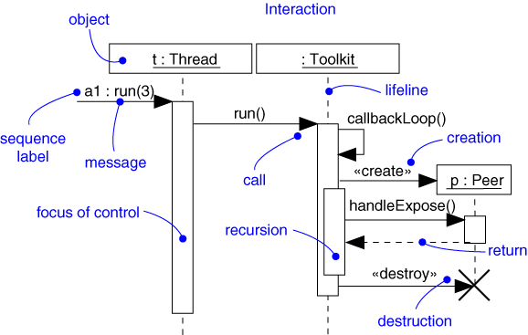
Sequence Diagram
Captures dynamic behavior (time-oriented)
Notes:
Focus of contrrol Aa symbol on a sequence diagraam that shows the period of time during which an object is performing an action directly or through a subordinate operation
In UML you can model several kind of actions
Call Invoke an operation on an object; an object may send amessage to it self, resulting in the local invocation of an operation
Return return a value to the caller
Send send a signal to an object
Creat creat an object
Destroy Destroy an object; an object may commit suicide by destroying itself
Objects may be created during the interaction. Their lifelines starts with the reciept of the message stereotyped as creat.
Objects may be destroyed during the interaction. Their lifeline end with the reciept of the message stereotypeed as destroy( and are given the visual cue of a large X, marking the end of their lives)

Slide 37
Sequence Diagram
Captures dynamic behavior (time-oriented)
Purpose
Model flow of control
Illustrate typical scenarios

Slide 38
Interactions - Modeling Actions
Simple
Call
Return
Send
asynchronous in 2.0 (stick arrowhead) – no return value expected at end of callee activation
activation of caller may end before callee’s (???)
half arrow in 1.x
c : Client
1
p : PlanningAgent
: TicketAgent
<<create>>
actual parameter
setItenerary( i )
calculateRoute()
loop
return
route
return value
call on self
for each conference
<<destroy>>
X
end of object life
notify()
send
destroy: e.g., in C++ manual garbage collection; in Java/C#, unnecessary
natural death/
self destruction
Additional considerations
To show nested messages, use ?.
To show constraints like time and space, use ?.
For formal flow of control, attach pre and post conditions to each message (?)

Slide 39
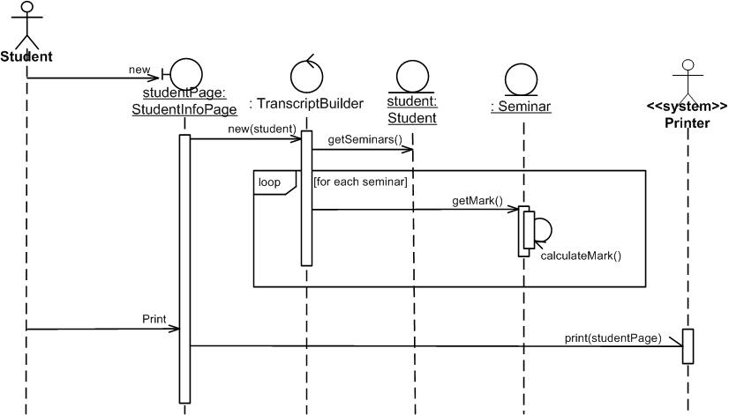
What can be in the top boxes? (http://www.agilemodeling.com/artifacts/sequenceDiagram.htm)
Boundary/interface elements: software elements such as screens, reports, HTML pages, or system interfaces that actors interact with.
Control/process elements (controllers): These serve as the glue between boundary elements and entity elements, implementing the logic required to manage the various elements and their interactions. Often implemented using objects, but simple ones using methods of an entity or boundary class.
Entity elements

Slide 40
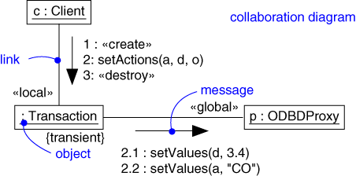
Collaboration Diagram
Captures dynamic behavior (message-oriented)
Notes:
A link specifies the path along with one object can dispatch a message to another (or the same ) object. Most ofthe time, it is sufficient to specify that such a path exixts. If you need to be moor precise about how that path exixts, you can adorn the appropriate end of the link with any of the following standard stereotype.
Association specifies that the corresponding object is visible by association
Self specifies that the corresponding object is visible because it is the dispatcher of the operation
Global specifies that the corresponding object is visible because it is in an enclosing scope
Local specifies that the corresponding object is visible because it is in a local scope
Parameter specifies that the corresponding object is visible because it is a parameter

Slide 41
Collaboration Diagram
Captures dynamic behavior (message-oriented)
Purpose
Model flow of control
Illustrate coordination of object structure and control

Slide 42
Interaction Overview Diagram (http://www.agilemodeling.com/artifacts/interactionOverviewDiagram.htm)
variants on UML activity diagrams which overview control flow.
The nodes within the diagram are frames, not activities
Two types of frame shown:
interaction frames depicting any type of UML interaction diagram (sequence diagram: sd, communication diagram: cd, timing diagram: td , interaction overview diagram: iod )
interaction occurrence frames (ref; typically anonymous) which indicate an activity or operation to invoke.
sd Enroll in Seminar lifelines :Student :Seminar :Course :Enrollment
ref
sd Determine Eligibility
Select Seminar()
:Student
:Seminar
:Course
{0..7msec}
[not eligible]
isEligible(std)
getPrereq ()
cd Determine Seat Availability
[seat available]
:Seminar
Number enrolled
:Enrollment
[no seat]
ref
AddToWaitingList()
ref
Enroll in Seminar()

Slide 43
Interaction Overview Diagram
sd Withdrawal
ref
Authenticate
PIN OK
PIN NOK
sd
sd
:User
:ATM
:Bank
:User
:ATM
withdraw
msg (“illegal entry”)
msg (“amount”)
amount (a)
chkAcct (a)
sd
sd
:User
:ATM
:Bank
:User
:ATM
:Bank
enough bal
not enough bal
money
msg(“amount too big”)
receipt
sd
:User
:ATM
Relationship with Sequence Diagram?
msg (“card”)

Slide 44
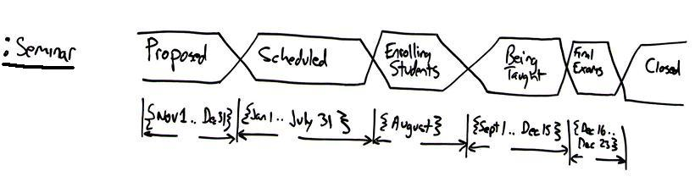
Interaction Diagram: Timing Diagram
To explore the behaviors of 0..* objects throughout a given period of time.
Two basic flavors: concise notation and robust notation
critical
states
Timing
constraints
The lifecycle of a single seminar
The critical states – Proposed, Scheduled, Enrolling Students, Being Taught, Final Exams, Closed
The two lines surrounding the states are called a general value lifeline.
When the two lines cross one another it indicates a transition point between states.
Timing constraints along the bottom of the diagram,
indicating the period of time during which the seminar is in each state.

Slide 45
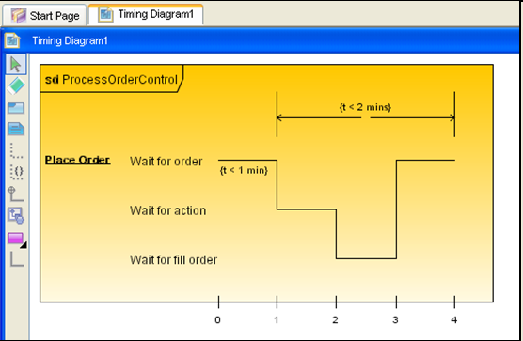
Interaction Diagram: Timing Diagram (robust notation)
http://www.visual-paradigm.com/highlight/highlightuml2support.jsp
states
state timeline
transition point
timing ruler w. tick marks
Can you transform this into a concise notation?

Slide 46
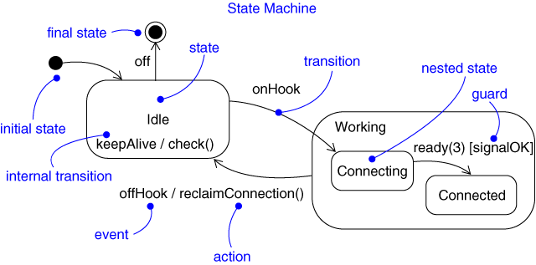
Statechart Diagram
Captures dynamic behavior (event-oriented)

Slide 47
Statechart Diagram
Captures dynamic behavior (event-oriented)
Purpose
Model object lifecycle
Model reactive objects (user interfaces, devices, etc.)

Slide 48
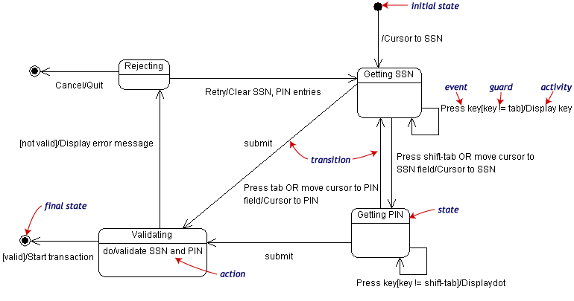
State Transition Example
Validating PIN/SSN

Slide 49
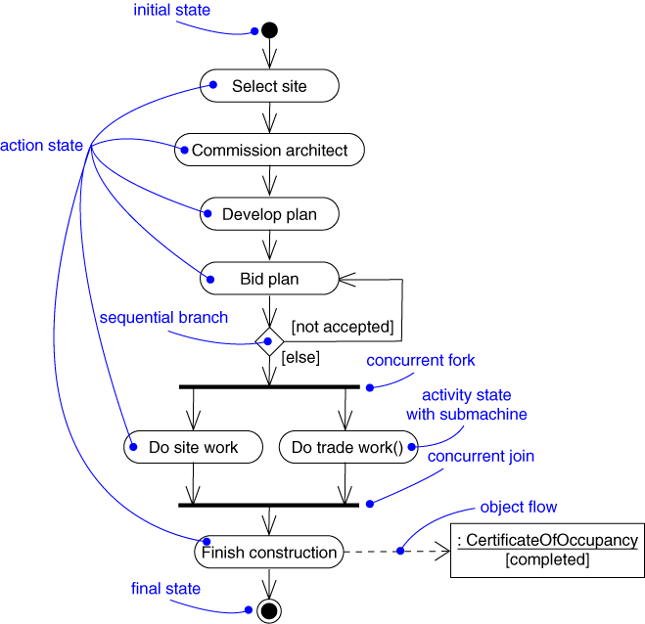
Activity Diagram
Captures dynamic behavior (activity-oriented)

Slide 50
Activity Diagram
Captures dynamic behavior (activity-oriented)
Purpose
Model business workflows
Model operations

Slide 51
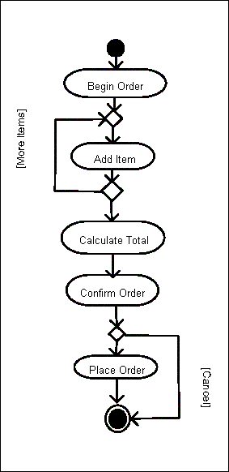
Sample Activity Diagram
Ordering System
May need multiple diagrams from other points of view

Slide 52
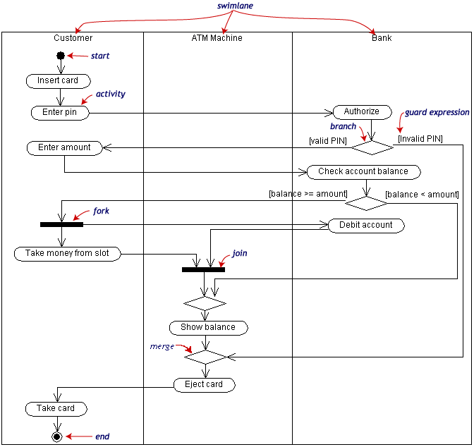
Activity Diagram Example

Slide 53
Package Diagrams
To organize complex class diagrams, you can group classes into packages. A package is a collection of logically related UML elements
Notation
Packages appear as rectangles with small tabs at the top.
The package name is on the tab or inside the rectangle.
The dotted arrows are dependencies. One package depends on another if changes in the other could possibly force changes in the first.
Packages are the basic grouping construct with which you may organize UML models to increase their readability

Slide 54
Package Example
DispatcherInterface
Notification
IncidentManagement

Slide 55
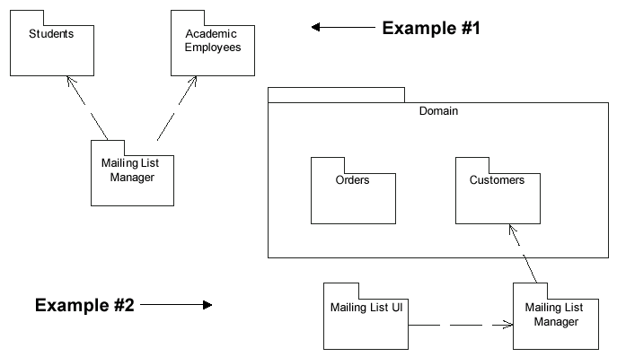
More Package Examples

Slide 56
Architecture and the UML
Design View
Implementation View
Classes, interfaces,
collaborations
Use cases
Components
Use Case View
Process View
Deployment View
Active classes
Nodes
Organization
Package, subsystem
Dynamics
Interaction
State machine

Slide 57
References
http://www.agilemodeling.com/
http://www.visual-paradigm.com/VPGallery/diagrams/index.html
http://bdn.borland.com/article/0,1410,31863,00.html
http://en.wikipedia.org/wiki/Unified_Modeling_Language
http://pigseye.kennesaw.edu/~dbraun/csis4650/A&D/UML_tutorial/index.htm

